Slide 1
Goals
To review how to use the linked lists provided in the standard library
To be able to use iterators to traverse linked lists
To understand the implementation of linked lists

Slide 2
Using Linked Lists
A linked list consists of a number of nodes, each of which has a reference to the next node
Adding and removing elements in the middle of a linked list is efficient
Visiting the elements of a linked list in sequential order is efficient
Random access is not efficient

Slide 3
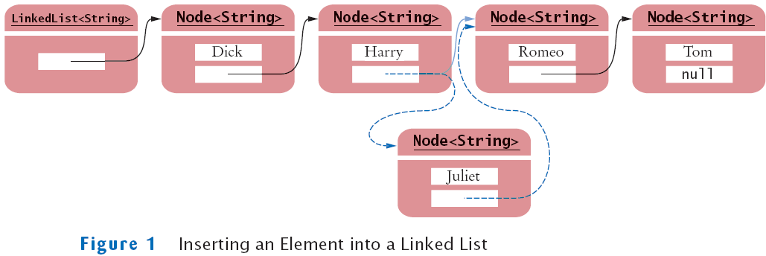
Inserting an Element into a Linked List

Slide 4
Java's LinkedList class
Generic class
Specify type of elements in angle brackets: LinkedList<Product>
Package: java.util
Easy access to first and last elements with methods void addFirst(E obj) void addLast(E obj) E getFirst() E getLast() E removeFirst() E removeLast()

Slide 5
List Iterator
ListIterator type
Gives access to elements inside a linked list
Encapsulates a position anywhere inside the linked list
Protects the linked list while giving access

Slide 6
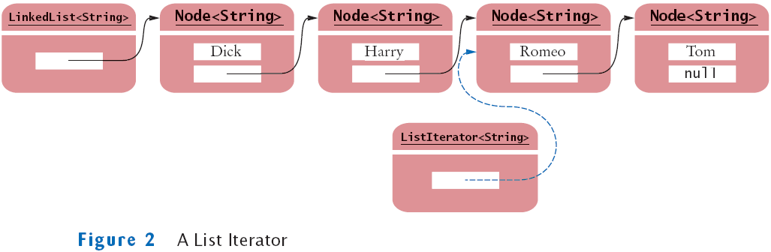
A List Iterator

Slide 7
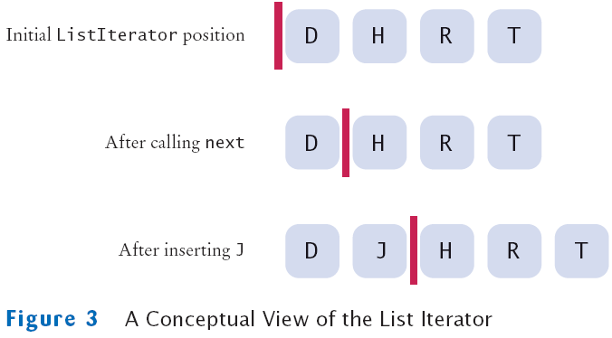
A Conceptual View of the List Iterator

Slide 8
List Iterator
Think of an iterator as pointing between two elements
Analogy: like the cursor in a word processor points between two characters
The listIterator method of the LinkedList class gets a list iterator LinkedList<String> employeeNames = . . .; ListIterator<String> iterator = employeeNames.listIterator();

Slide 9
List Iterator
Initially, the iterator points before the first element
The next method moves the iterator iterator.next();
next throws a NoSuchElementException if you are already past the end of the list
hasNext returns true if there is a next element if (iterator.hasNext()) iterator.next();

Slide 10
List Iterator
The next method returns the element that the iterator is passing while iterator.hasNext() { String name = iterator.next(); Do something with name }
Shorthand: for (String name : employeeNames) { Do something with name } Behind the scenes, the for loop uses an iterator to visit all list elements

Slide 11
List Iterator
LinkedList is a doubly linked list
Class stores two links:
One to the next element, and
One to the previous element
To move the list position backwards, use:
hasPrevious
previous

Slide 12
Adding and Removing from a LinkedList
The add method:
Adds an object after the iterator
Moves the iterator position past the new element
iterator.add("Juliet");

Slide 13
Adding and Removing from a LinkedList
The remove method
Removes and
Returns the object that was returned by the last call to next or previous
//Remove all names that fulfill a certain condition while (iterator.hasNext()) { String name = iterator.next(); if (name fulfills condition) iterator.remove(); }
Be careful when calling remove:
It can be called only once after calling next or previous
You cannot call it immediately after a call to add
If you call it improperly, it throws an IllegalStateException

Slide 14
Sample Program
ListTester is a sample program that
Inserts strings into a list
Iterates through the list, adding and removing elements
Prints the list

Slide 15
ch15/uselist/ListTester.java
01: import java.util.LinkedList;
02: import java.util.ListIterator;
03:
04: /**
05: A program that tests the LinkedList class
06: */
07: public class ListTester
08: {
09: public static void main(String[] args)
10: {
11: LinkedList<String> staff = new LinkedList<String>();
12: staff.addLast("Dick");
13: staff.addLast("Harry");
14: staff.addLast("Romeo");
15: staff.addLast("Tom");
16:
17: // | in the comments indicates the iterator position
18:
19: ListIterator<String> iterator
20: = staff.listIterator(); // |DHRT
21: iterator.next(); // D|HRT
22: iterator.next(); // DH|RT
Continued

Slide 16
ch15/uselist/ListTester.java (cont.)
23:
24: // Add more elements after second element
25:
26: iterator.add("Juliet"); // DHJ|RT
27: iterator.add("Nina"); // DHJN|RT
28:
29: iterator.next(); // DHJNR|T
30:
31: // Remove last traversed element
32:
33: iterator.remove(); // DHJN|T
34:
35: // Print all elements
36:
37: for (String name : staff)
38: System.out.print(iterator.next() + " ");
39: System.out.println();
40: System.out.println("Expected: Dick Harry Juliet Nina Tom");
41: }
42: }

Slide 17
ch15/uselist/ListTester.java (cont.)
Output:
Dick Harry Juliet Nina Tom Expected: Dick Harry Juliet Nina Tom

Slide 18
Fundamental Operations on Linked List
public class LinkedList { public ListIterator listIterator() {. . .} . . . } public interface ListIterator { Object next(); boolean hasNext(); void add(Object value); void remove(); void set(Object value); . . . }

Slide 19
Efficiency of Operations for Arrays and Lists
Adding or removing an element
A fixed number of node references need to be modified to add or remove a node, regardless of the size of the list
In big-Oh notation: O(1)
Adding or removing an element
On average n/2 elements need to be moved
In big-Oh notation: O(n)

Slide 20
Implementing a Linked List
While learning how to use the Java library is important, it is equally important to understand how it works internally in case programming in a language without libraries.

Slide 21
Nodes in Linked Lists
A linked list consists of nodes. Each node contains an element, and each node is linked to its next neighbor. Thus a node can be defined as a class, as follows:
class Node<E> {
E element;
Node<E> next;
public Node(E o) {
element = o;
}
}

Slide 22
Adding Three Nodes
The variable head refers to the first node in the list, and the variable tail refers to the last node in the list. If the list is empty, both are null. For example, you can create three nodes to store three strings in a list, as follows:
Step 1: Declare head and tail:

Slide 23
Adding Three Nodes, cont.
Step 2: Create the first node and insert it to the list:

Slide 24
Adding Three Nodes, cont.
Step 3: Create the second node and insert it to the list:

Slide 25
Adding Three Nodes, cont.
Step 4: Create the third node and insert it to the list:

Slide 26
Traversing All Elements in the List
Each node contains the element and a data field named next that points to the next node. If the node is the last in the list, its pointer data field next contains the value null. You can use this property to detect the last node. For example, you may write the following loop to traverse all the nodes in the list.
Node<E> current = head;
while (current != null) {
System.out.println(current.element);
current = current.next;
}

Slide 27
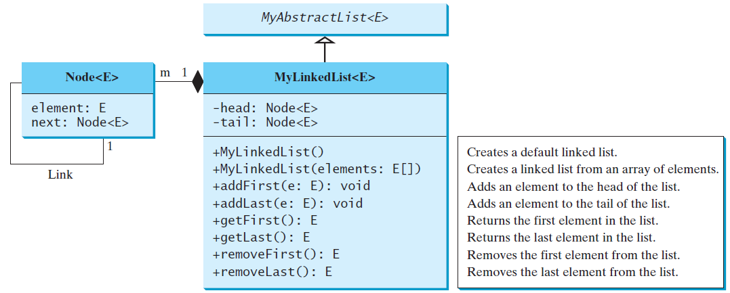
MyLinkedList
MyLinkedList
TestMyLinkedList

Slide 28
Implementing addFirst(E e)
public void addFirst(E e) {
Node<E> newNode = new Node<>(e);
newNode.next = head;
head = newNode;
size++;
if (tail == null)
tail = head;
}

Slide 29
Implementing addLast(E e)
public void addLast(E e) {
if (tail == null) {
head = tail = new Node<>(e);
}
else {
tail.next = new Node<>(e);
tail = tail.next;
}
size++;
}

Slide 30
Implementing add(int index, E e)
public void add(int index, E e) {
if (index == 0) addFirst(e);
else if (index >= size) addLast(e);
else {
Node<E> current = head;
for (int i = 1; i < index; i++)
current = current.next;
Node<E> temp = current.next;
current.next = new Node<>(e);
(current.next).next = temp;
size++;
}
}

Slide 31
Implementing removeFirst()
public E removeFirst() {
if (size == 0) return null;
else {
Node<E> temp = head;
head = head.next;
size--;
if (head == null) tail = null;
return temp.element;
}
}

Slide 32
Implementing removeLast()
public E removeLast() {
if (size == 0) return null;
else if (size == 1)
{
Node<E> temp = head;
head = tail = null;
size = 0;
return temp.element;
}
else
{
Node<E> current = head;
for (int i = 0; i < size - 2; i++)
current = current.next;
Node temp = tail;
tail = current;
tail.next = null;
size--;
return temp.element;
}
}

Slide 33
Implementing remove(int index)
public E remove(int index) {
if (index < 0 || index >= size) return null;
else if (index == 0) return removeFirst();
else if (index == size - 1) return removeLast();
else {
Node<E> previous = head;
for (int i = 1; i < index; i++) {
previous = previous.next;
}
Node<E> current = previous.next;
previous.next = current.next;
size--;
return current.element;
}
}

Slide 34
Circular Linked Lists
A circular, singly linked list is like a singly linked list, except that the pointer of the last node points back to the first node.

Slide 35
Doubly Linked Lists
A doubly linked list contains the nodes with two pointers. One points to the next node and the other points to the previous node. These two pointers are conveniently called a forward pointer and a backward pointer. So, a doubly linked list can be traversed forward and backward.

Slide 36
Circular Doubly Linked Lists
A circular, doubly linked list is doubly linked list, except that the forward pointer of the last node points to the first node and the backward pointer of the first pointer points to the last node.

